Slide 1






Lecture 12:
Introduction to Promises
Course - Web Development - II
-By
Instructor Name
‹#›
welcome@krmangalam.edu.in
Sohna Road,Gurugram,Haryana 122103

Slide 2

| Table of Contents
Promises
References.
The End.
‹#›

Slide 3

|
Do you know that just like in real life we make promises to do something later… JavaScript can also make promises to do work later?
‹#›

Slide 4

|
Do you know that just like in real life we make promises to do something later… JavaScript can also make promises to do work later?
Can you think of something you’ve promised to do later but didn't do on time?
Imagine you promised your teacher that you'll submit your homework tomorrow.
You're still doing the homework. It's not ready yet. Homework in progress
You finished it and gave it to the teacher.
Homework submitted
You didn’t do it at all or forgot to bring it.
Promise broken
‹#›

Slide 5
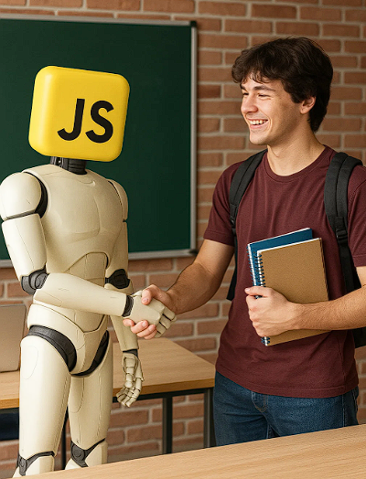
|
Do you know that just like in real life we make promises to do something later… JavaScript can also make promises to do work later?
JavaScript also does the exact same thing!
Yes — it can also make promises!
Just like you promise to do something later, JavaScript promises to complete a task later — maybe after 2 seconds, or after downloading something, or after waiting for the user.
So, JavaScript is behaving like a student!
‹#›

Slide 6
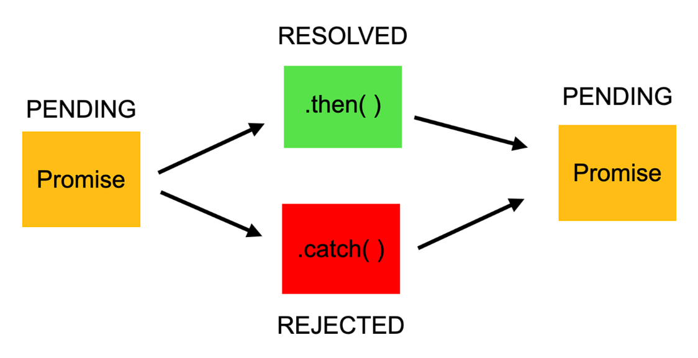
| Promises
A Promise is a built-in JavaScript object that represents the eventual completion or failure of an asynchronous operation
States of a Promise:
Pending – The initial state; the operation has not completed yet.
Fulfilled – The operation completed successfully.
Rejected – The operation failed with an error.
‹#›

Slide 7
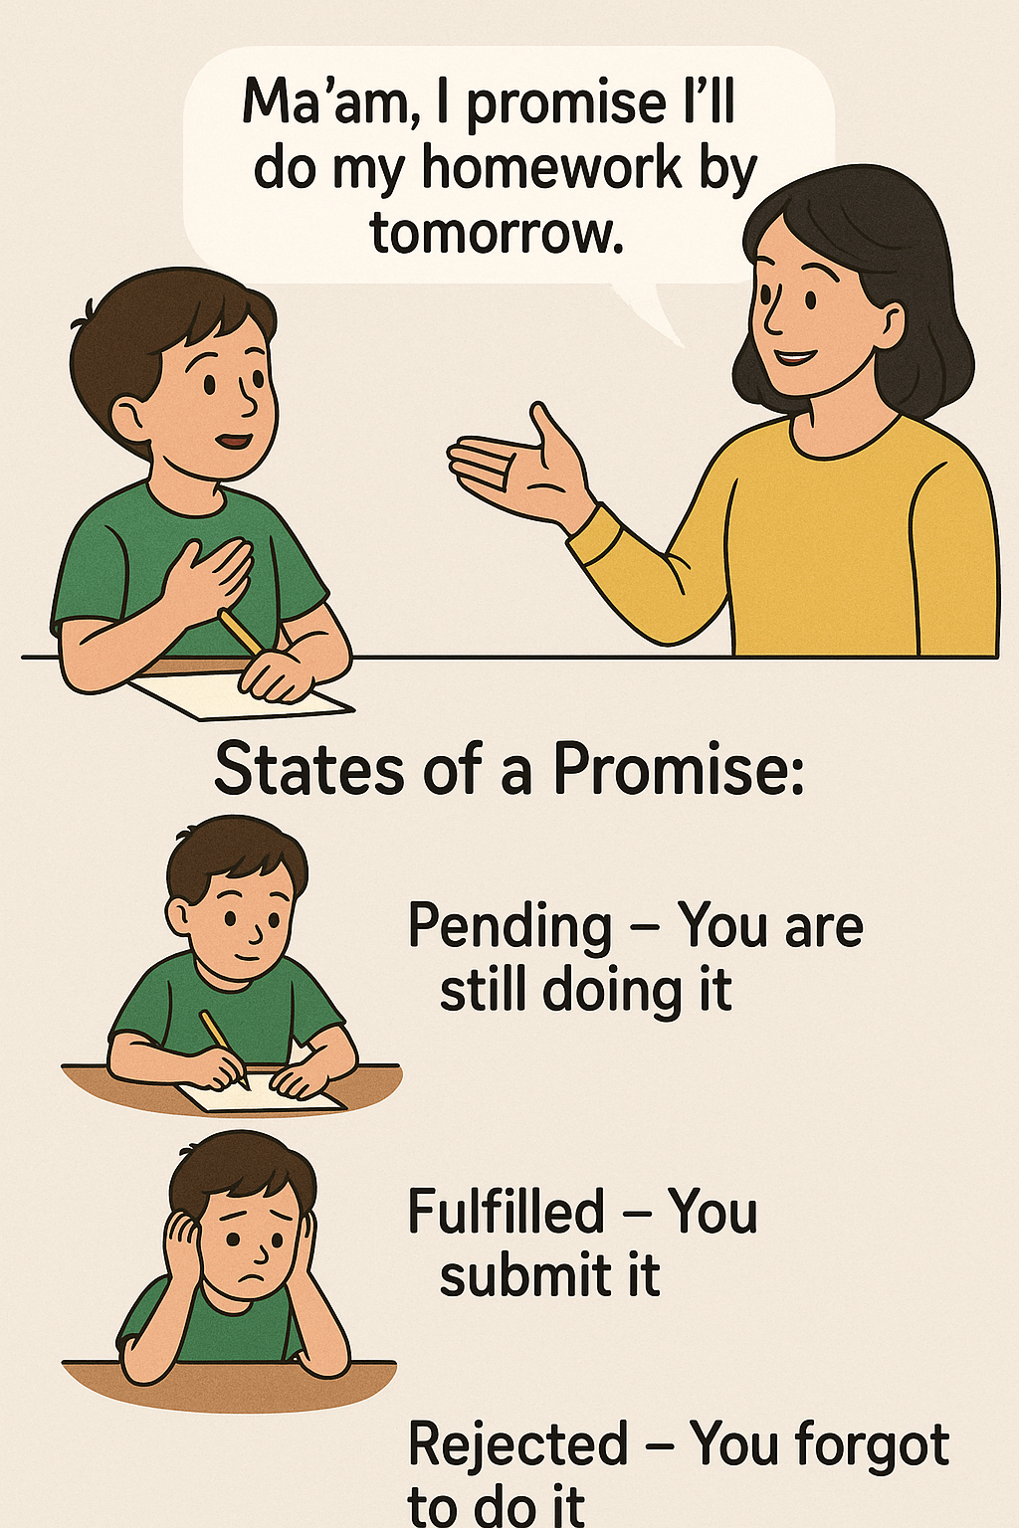
| Promises
Real-Life Recap
Ma’am, I promise I’ll do my homework by tomorrow
States of a Promise:
Pending – You are still doing it
Fulfilled –You submit it
Rejected – You forgot to do it
‹#›

Slide 8
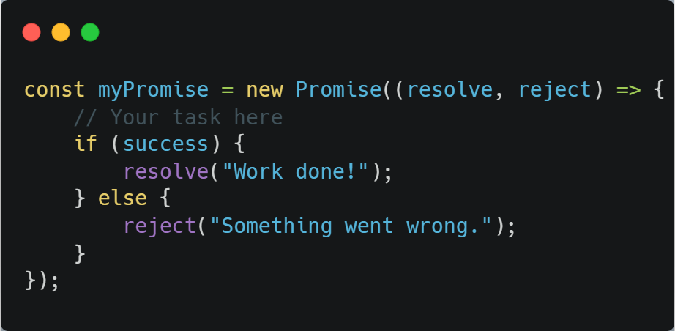
| Promises
Basic Promise Syntax:
creating a new promise
Call this when the job is done
Call this when the job fails
I Promise you !
resolve and reject are two methods given by the Promise.
resolve(): Call when the task is completed successfully
reject(): Call when the task fails or doesn't complete
‹#›

Slide 9
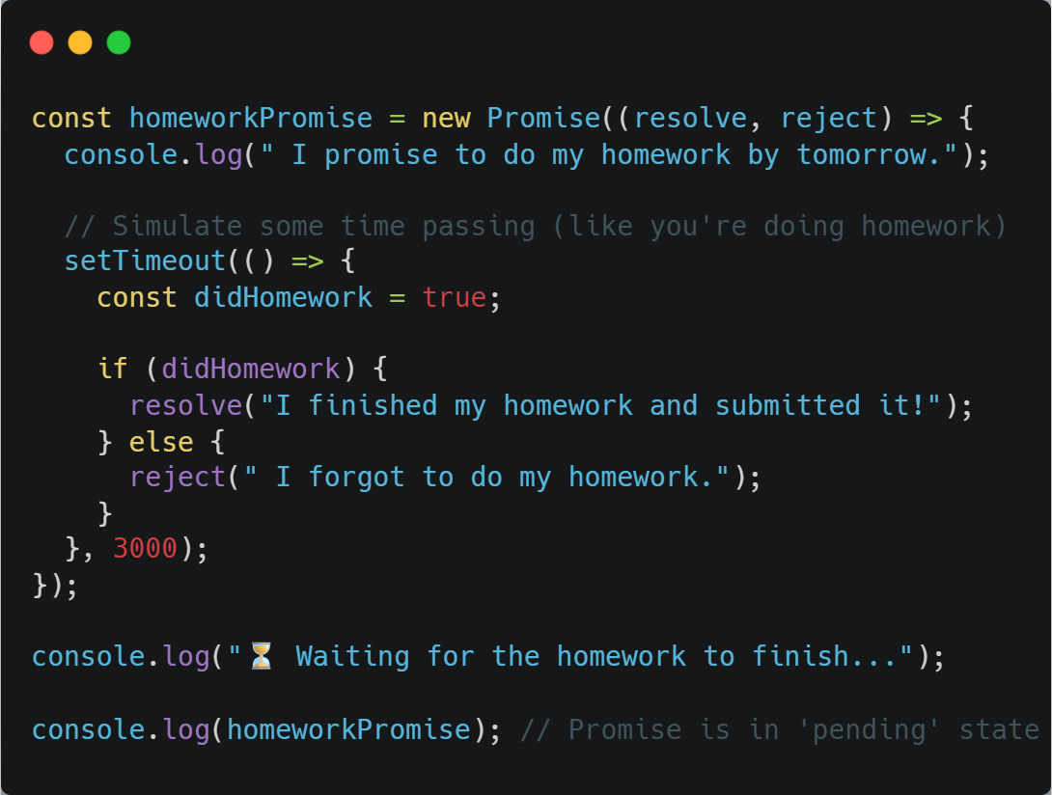
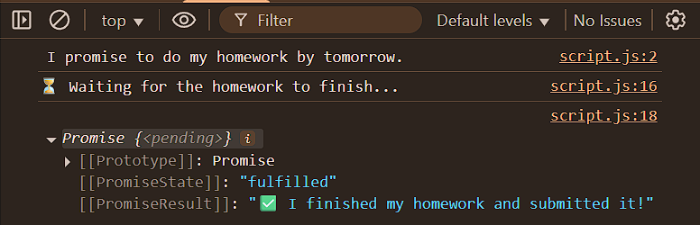
| Promises
Output
Promise fulfilled
‹#›

Slide 10
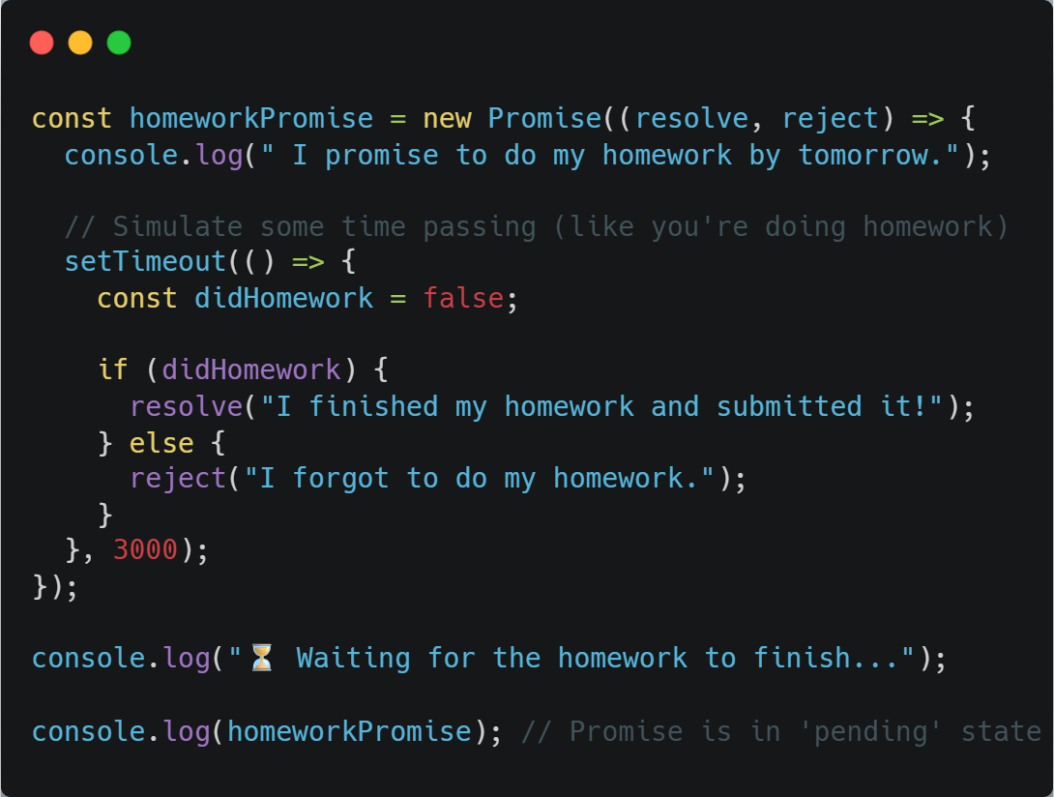
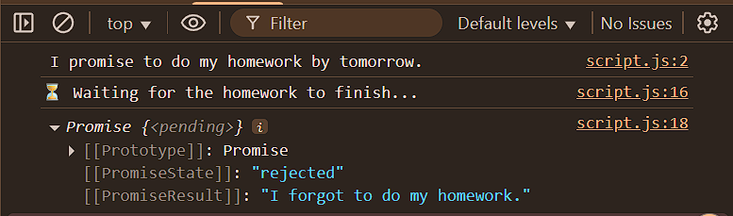
| Promises
Output
Promise failed
‹#›

Slide 11

|
Have you ever made more than one promise in a row?
‹#›

Slide 12
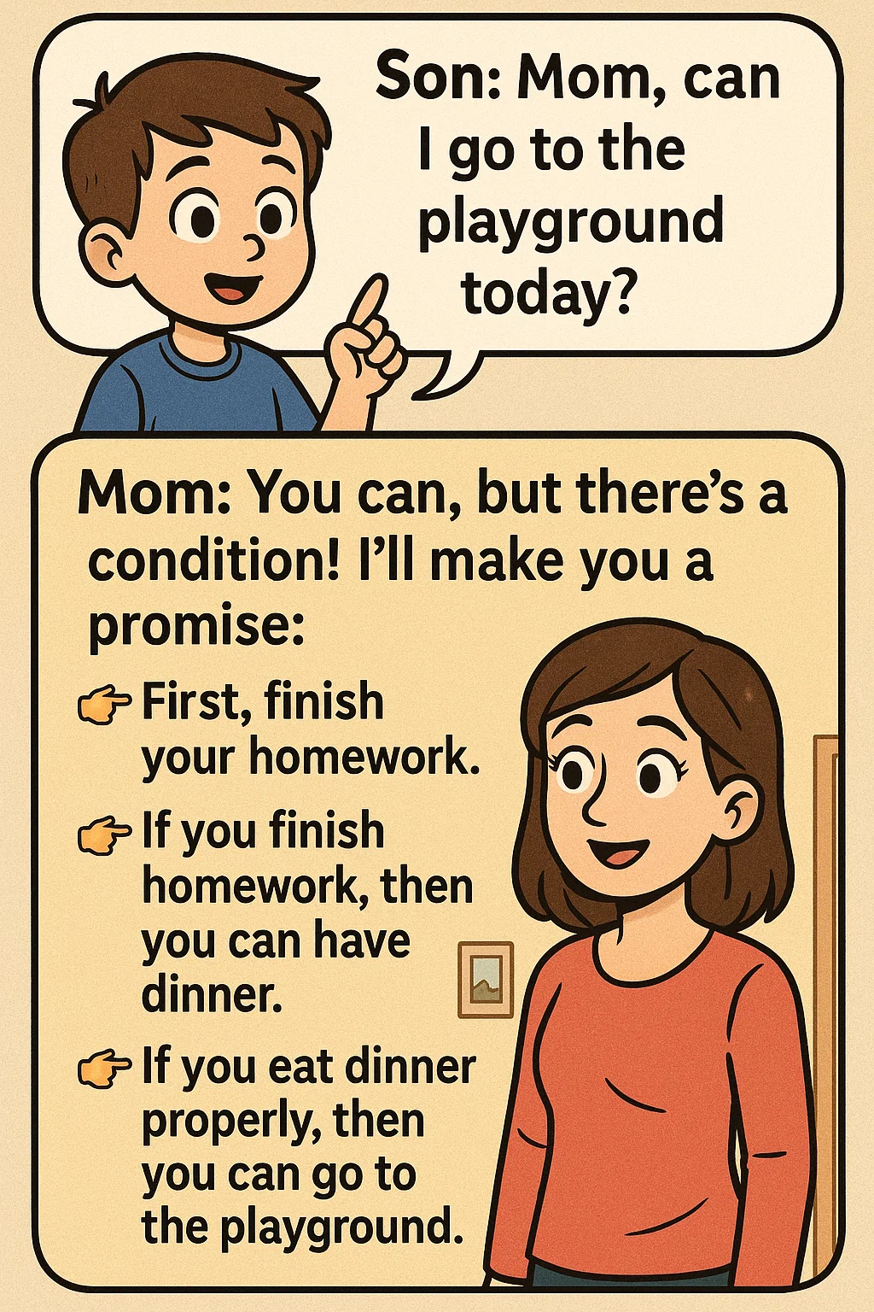
|
Have you ever made more than one promise in a row?
Example: Conversation with mom and son
Son: Mom, can I go to the playground today?
Mom: You can, but there’s a condition!
Promise 1 : First, finish your homework.
Promise 2 : If you finish homework, then you can have Dinner.
Promise 3 : If you eat dinner properly, then you can go to the
playground.
‹#›

Slide 13
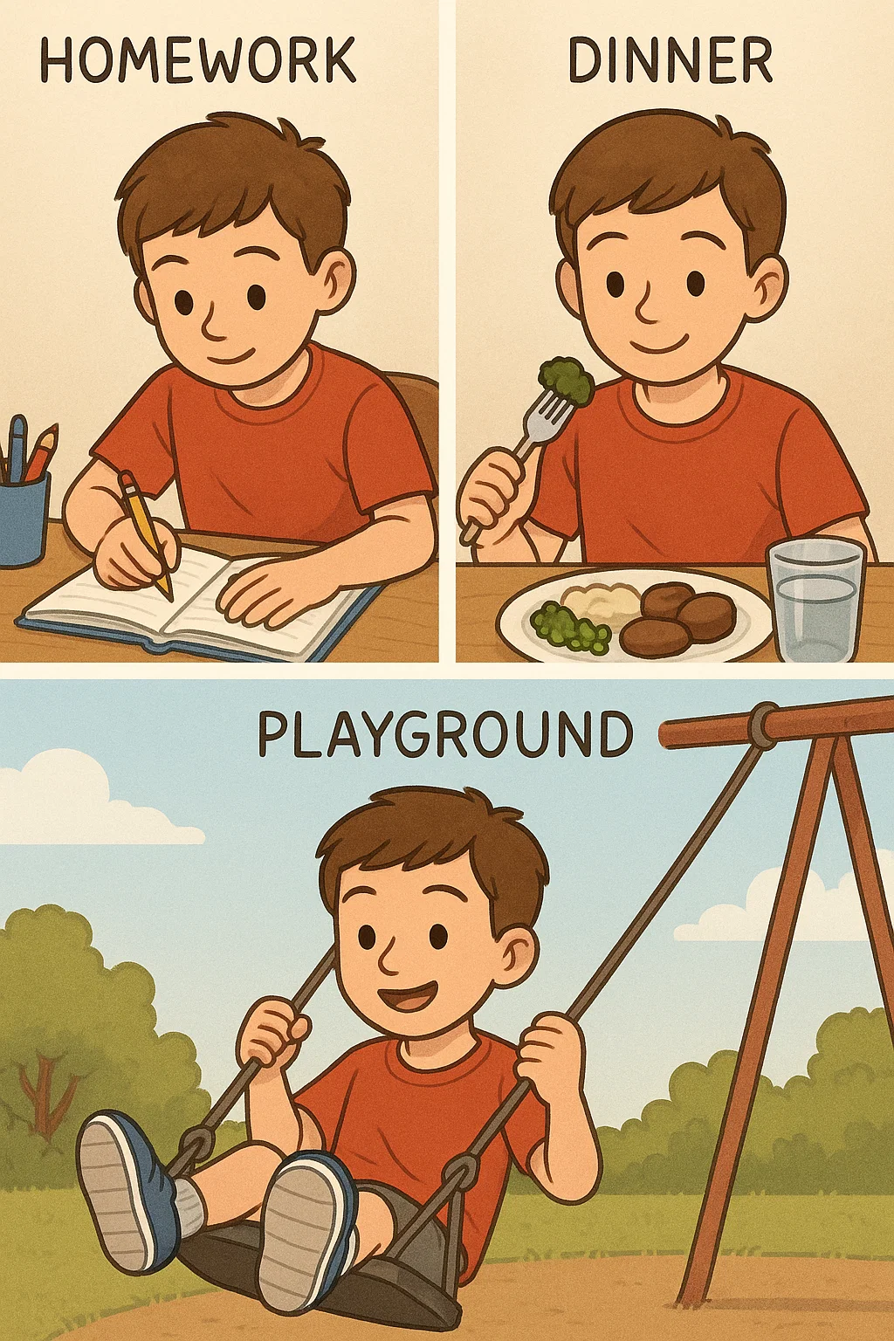
|
Did you notice how each Promise depends on the previous one Homework → Dinner → Playground
This is Called Dependency
That means:
You can only eat dinner if homework is done.
You can only go to the playground if dinner is done.
‹#›

Slide 14
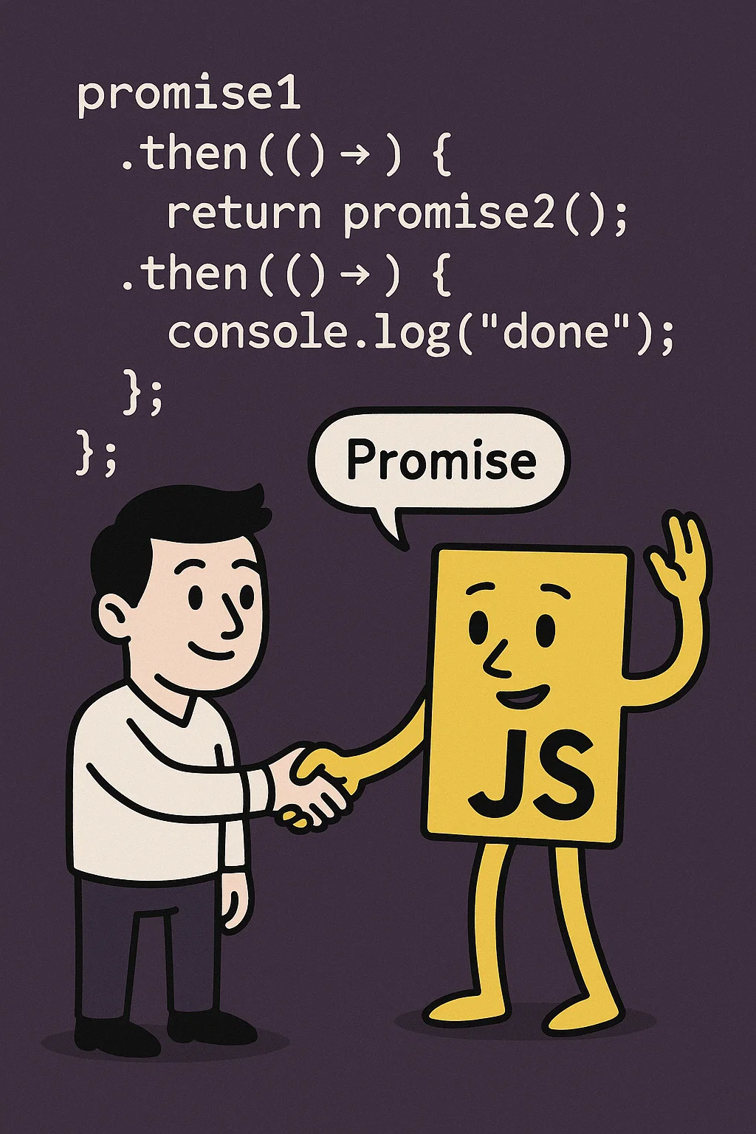
|
Did you know that, just like in real life, we can make one promise depend on the result of a previous promise? JavaScript can do the same — it allows one promise to depend on the outcome of another!
‹#›

Slide 15

| Coding Questions
1. Creating a Promise
Task :
Create a function delay(ms) that returns a new Promise. This Promise should use setTimeout to wait for the specified number of milliseconds (ms) and then resolve with the message "Action completed after [ms] ms".
‹#›

Slide 16
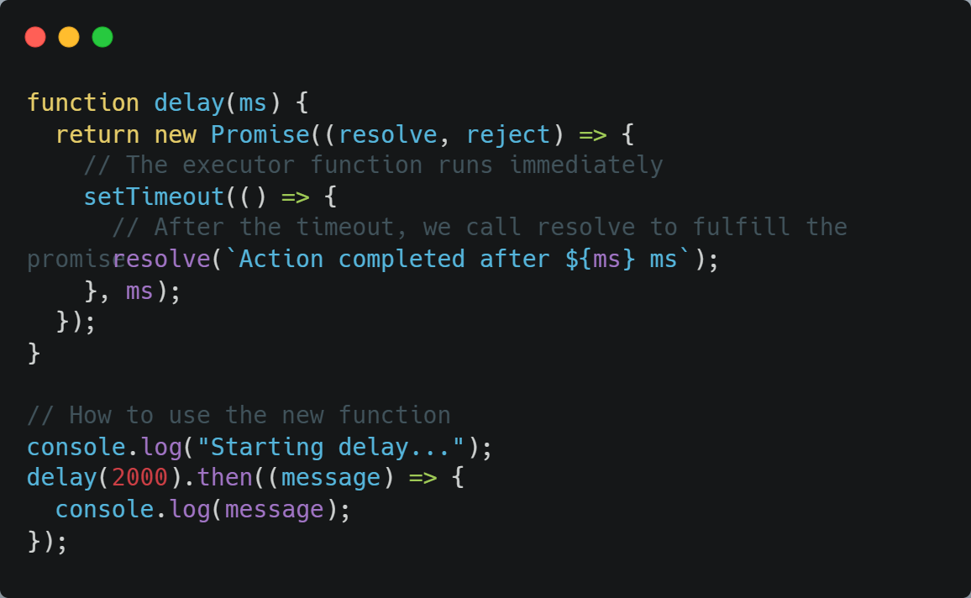
| Coding Questions
Solution :
‹#›

Slide 17
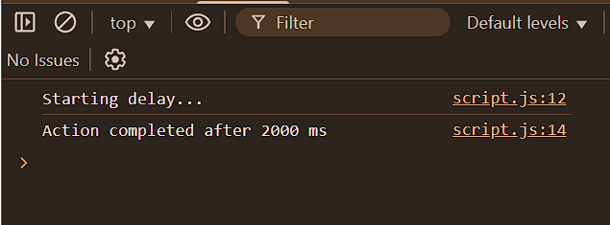
| Coding Questions
Output :
‹#›

Slide 18
| Check Your Understanding
Question : What is a JavaScript Promise?
Options : a) A guarantee that a function will not have any errors.
b) A function that runs synchronously.
c) An object that represents the eventual completion (or failure) of an asynchronous operation.
d) A special type of variable for storing boolean values.
Answer : c) An object that represents the eventual completion (or failure) of an
asynchronous operation.
Explanation:
A Promise is a placeholder for a future value. It allows you to write asynchronous code that is easier to manage than traditional callbacks.
‹#›

Slide 19
| Check Your Understanding
Question : What are the three states a Promise can be in?
Options : a) Start, Middle, End
b) Ready, Set, Go
c) Pending, Fulfilled, Rejected
d) Async, Await, Sync
Answer : c) Pending, Fulfilled, Rejected
Explanation:
A Promise starts as pending, and once the asynchronous operation is complete, it settles into either a fulfilled (successful) or rejected (failed) state.
‹#›

Slide 20
| References
MDN Web Docs : Comprehensive and official documentation for JS. 🔗https://developer.mozilla.org/en-US/docs/Web/JavaScript
W3Schools – JS Tutorial : Beginner-friendly JS tutorials with examples and interactive editors. 🔗 https://www.w3schools.com/js/
JavaScript.info - A comprehensive tutorial-style website that covers core JavaScript concepts in depth.
🔗https://javascript.info/
‹#›

Slide 21
Thanks
For
Watching
Course - Web Development - II
‹#›
welcome@krmangalam.edu.in
Sohna Road,Gurugram,Haryana 122103

